Slide 1
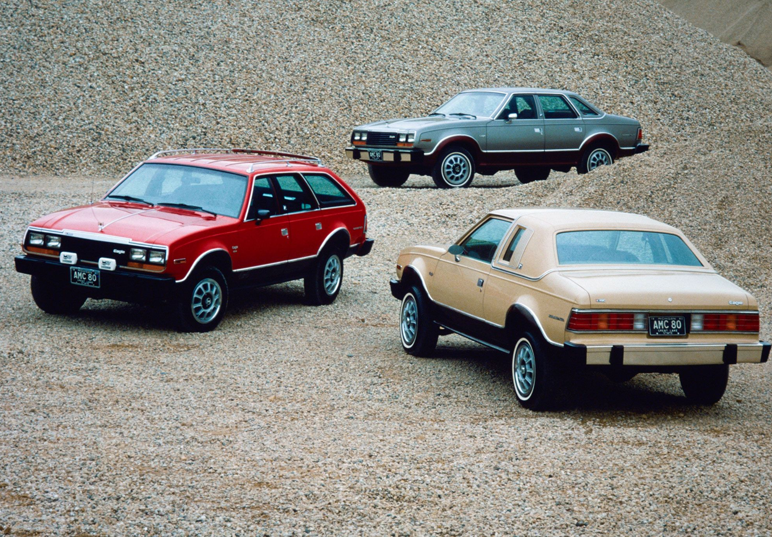
Stats Case Study
Presented By Ben, Brandon, Chris, and Isaac
Notes:
Hello everyone, we are Team DAMIL06 and we will be presenting this sprints case study.

Slide 2
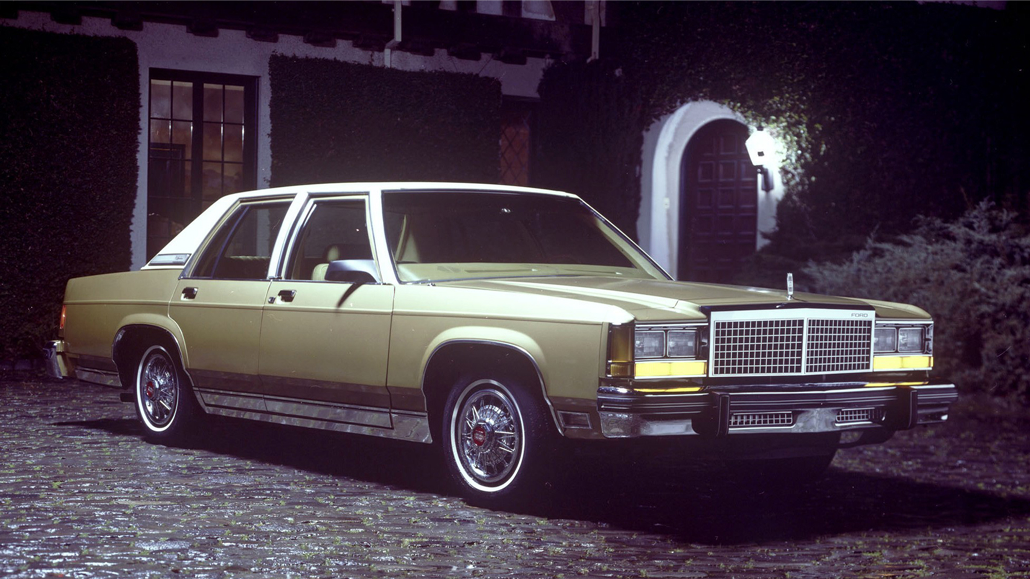
OVERVIEW
Hypothesis
Data used
Data Path
Data Results
Conclusion
Notes:
Here is the overview of what we will be going over, Our Hypothesis, the data used, the path we took to gather that data, results from the data captured and finally our conclusion to include if that data accepted or denied our hypothesis.

Slide 3
Hypothesis
Cylinders vs. MPG:
H0: 4 cylinder engines accelerations averages are significantly GREATER than or equal to 6 cylinders engines
Ha: 4 cylinder engines accelerations averages are significantly LESS than 6 cylinders engines

Slide 4



Data used
Vehicles Years:
1970-1980
Initial Layout:
9 columns and 398 rows
Notes:
mpg, cylinders, displacement, horsepower, weight, acceleration, model, origin, car_name

Slide 5
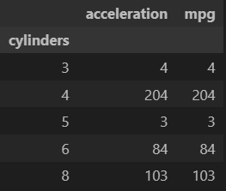
Data Path
Original Analysis Intention- Compare all cylinder categories
Cylinder categories narrowed down to 4 and 6 cylinders
3 and 5 cylinder categories excluded due to lack of data
8 cylinder category excluded due to non-comparable data for defined criteria
Methods Used
T Test- A test that compares the averages of two groups
Plotting and Charting- Visually explain the data results from the tests completed
Notes:
Our original analysis intention was to compare all the cylinders together but after we decided the data, we were able to get a better picture of what can be used and what wouldn’t add value to our testing. That is what led us to narrow down the data, focusing on the 4 and 6 cylinder categories. 3 and 5 did not have enough data and 8’s data was not a good set of comparable data , it would of provided us with false conclusions.
So how did we analyze the data? We used the T-Test Method which basically compares the average of two group of data information. Then based on those results, we graphed them to show our finding in a visual manner that is easy to comprehend without diving deep into the data. The upcoming slides will display that along with expressing our conclusion.

Slide 6
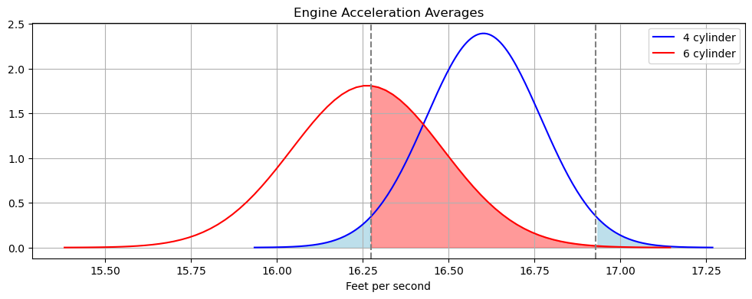
Data Results
4 Cylinder Average - 16.60
6 Cylinder Average - 16.26

Slide 7
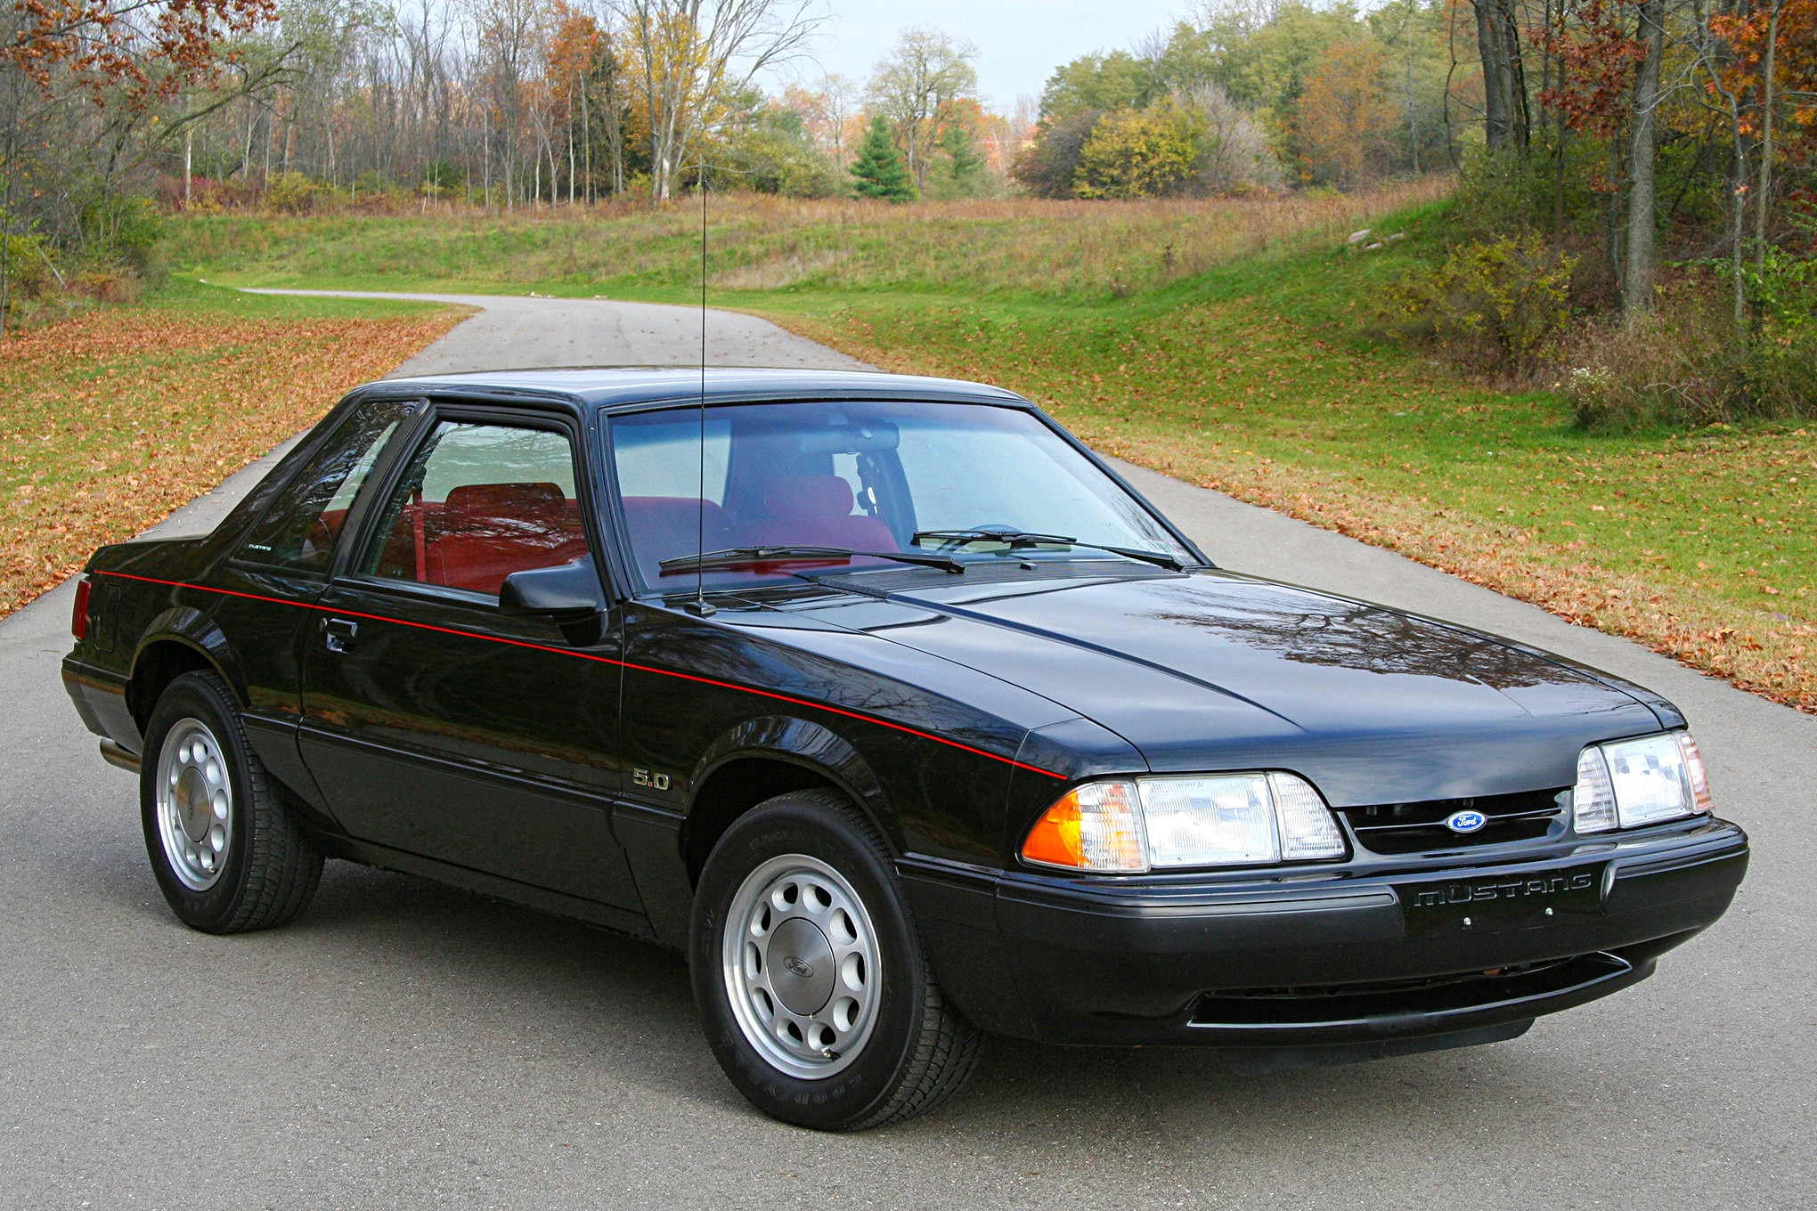
Conclusion
Not enough significant difference between 4 and 6 cylinders
Failed to reject Null Hypothesis
“4 cylinder engines accelerations averages are significantly GREATER than or equal to 6 cylinders engines”

